Slide 1

Covid -19 statistics

Slide 2
Introduction my App : Covid-19 Statistics is Mobile Application use to show up all world countries updated Cases , Infected , Tested , Recovered , Deceased , News of corona virus.

Slide 3
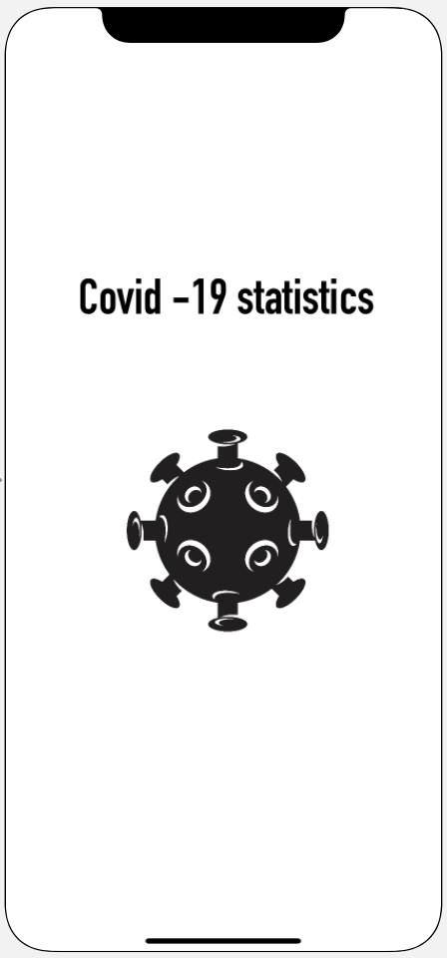
Content :
1- project details
2- project description
3- picture for project

Slide 4
Project Description My App Covid- 19 Statistics depend on fire base with swift language by xcode Features List : 1- show for users updated covid cases and news 2-using API to call up the data

Slide 5
Users stories : - ( login / Register) - as a user I want to register to the app so I can be accessed to the system -( covid page) - as a user I can see the pandemic statistics Recovered , Infected , Tested , Deceased

Slide 6
News page : as a user I want to know updated news about the pandemic.

Slide 7
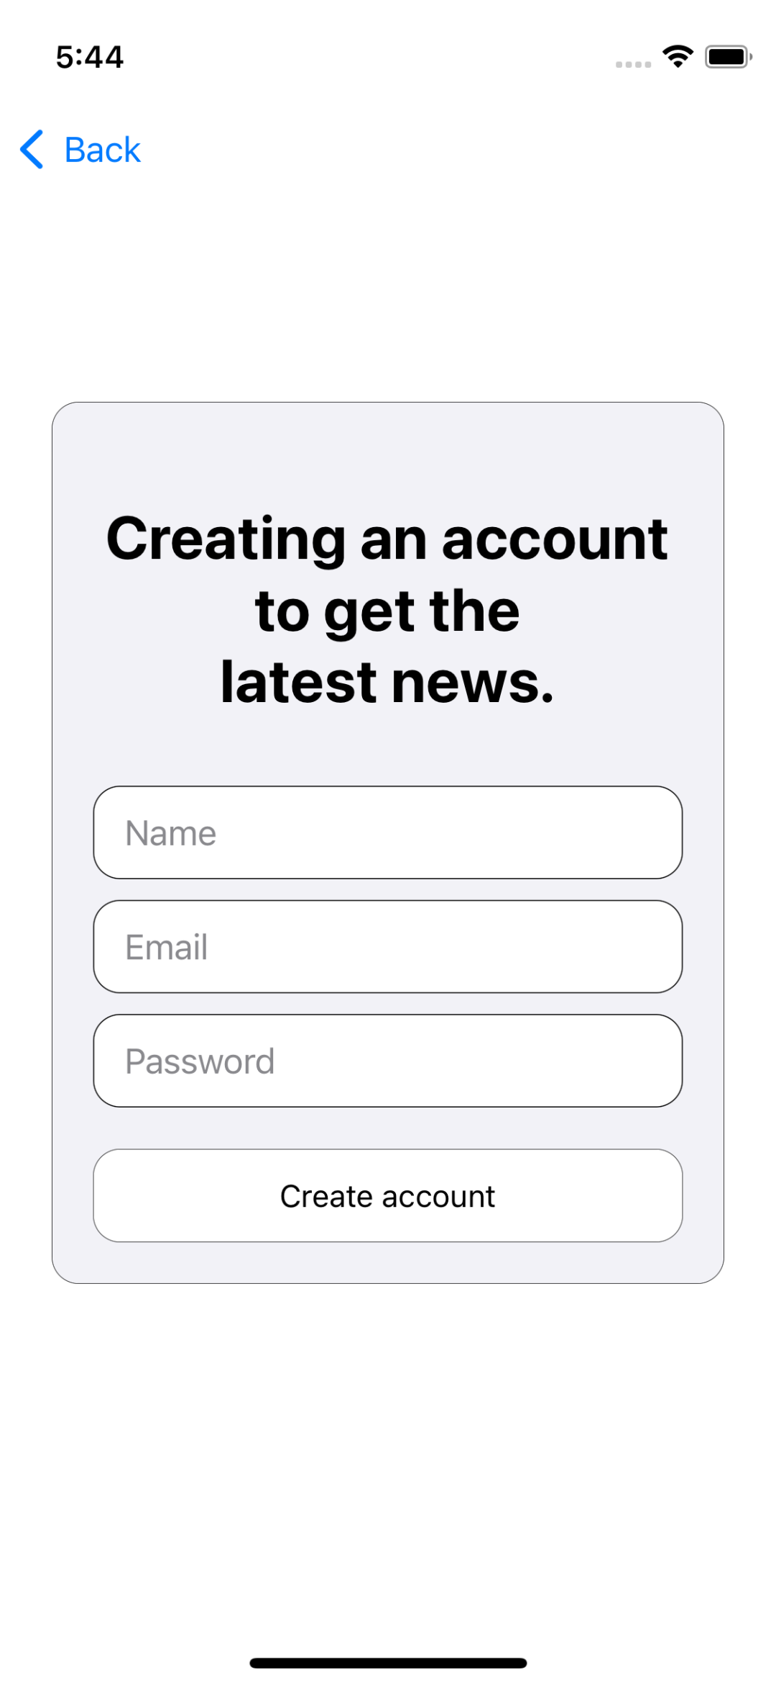
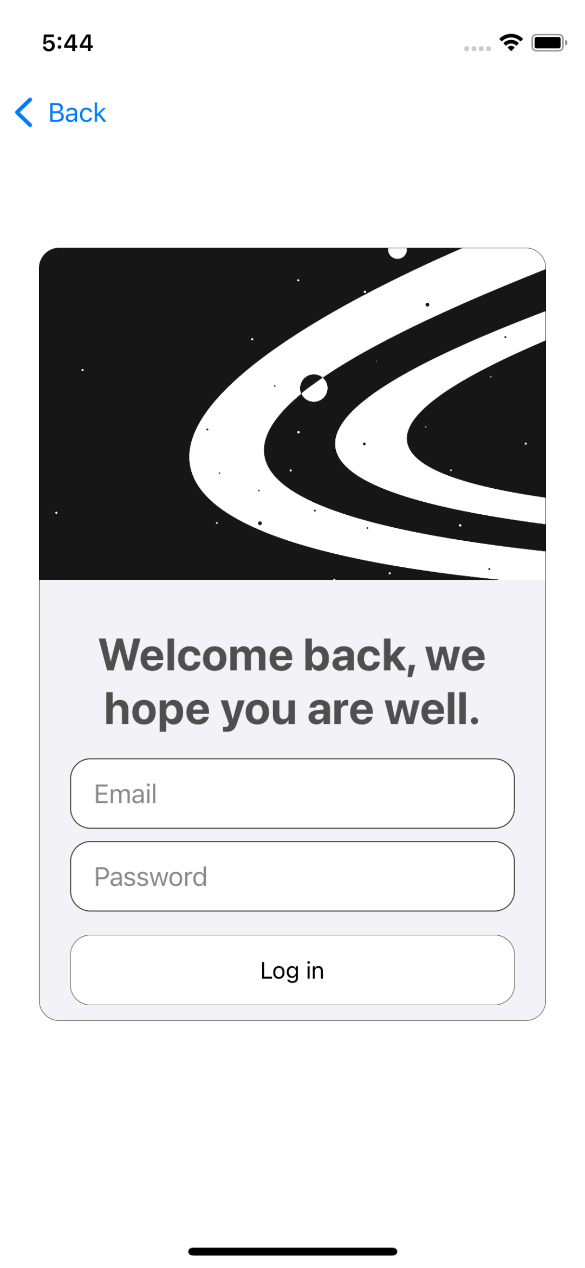
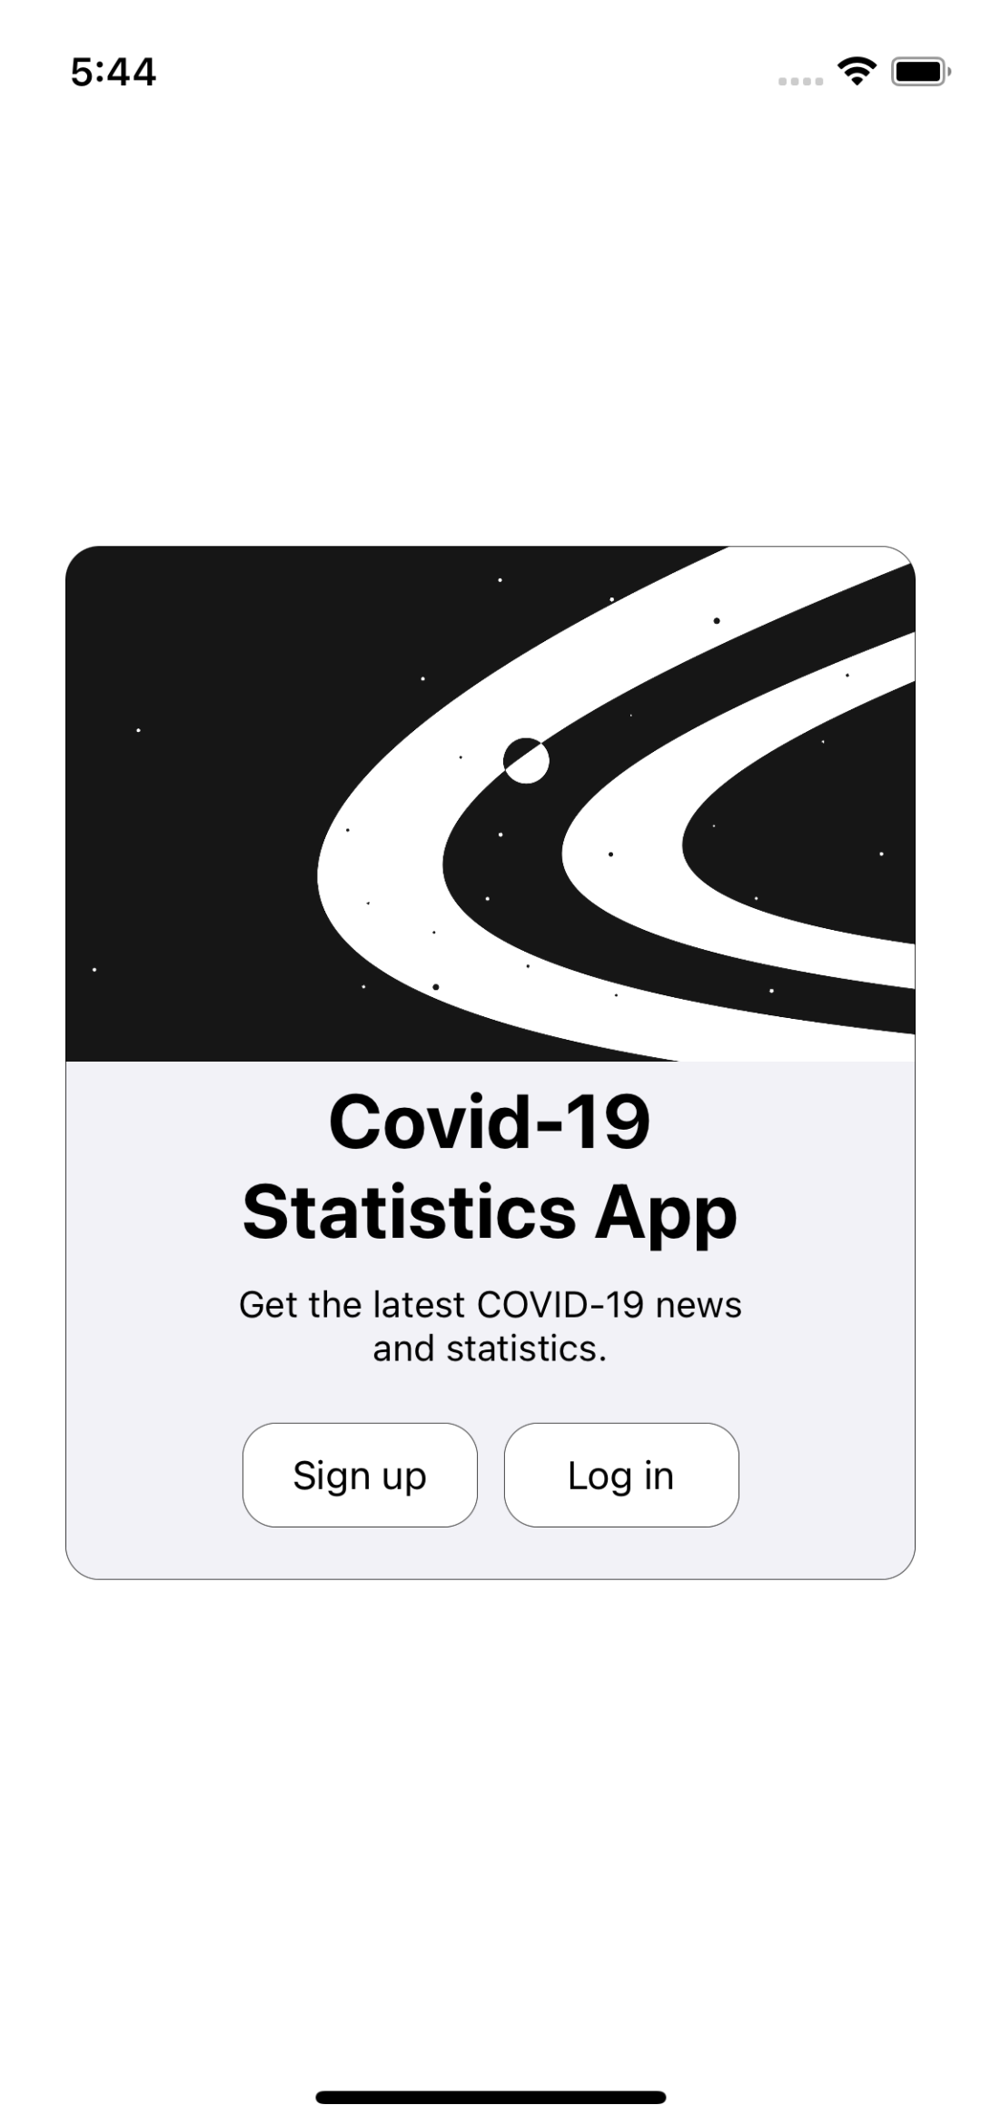
welcome screen , log in , sign up

Slide 8
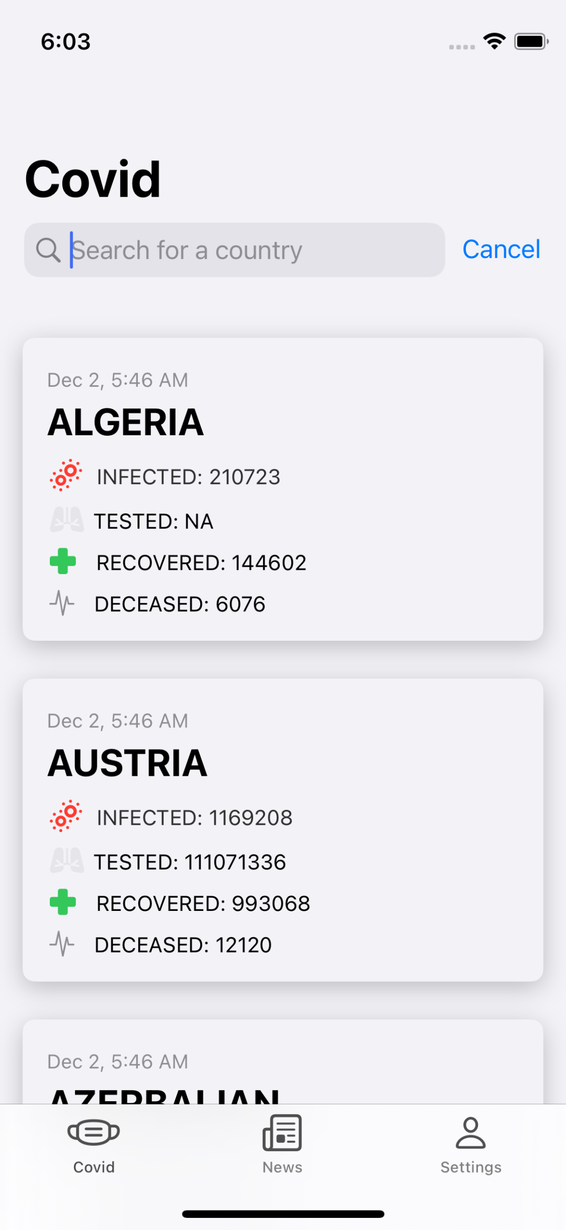
Cases page : you can see all cases number , and search for every country

Slide 9
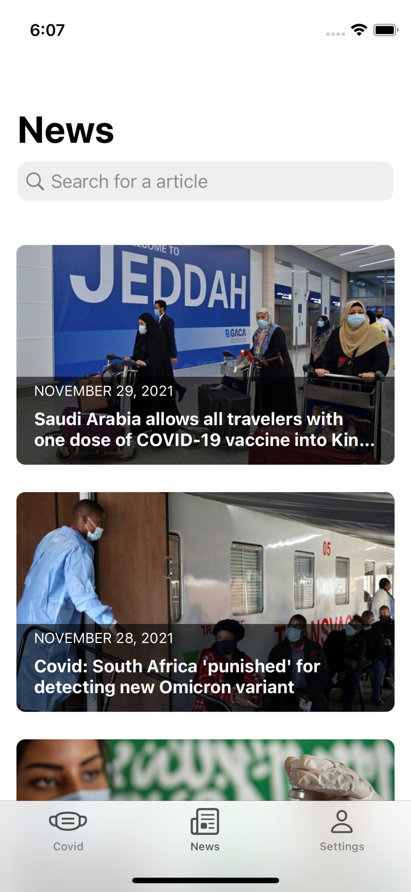

News page : You can read about pandamic news and updateds .

Slide 10
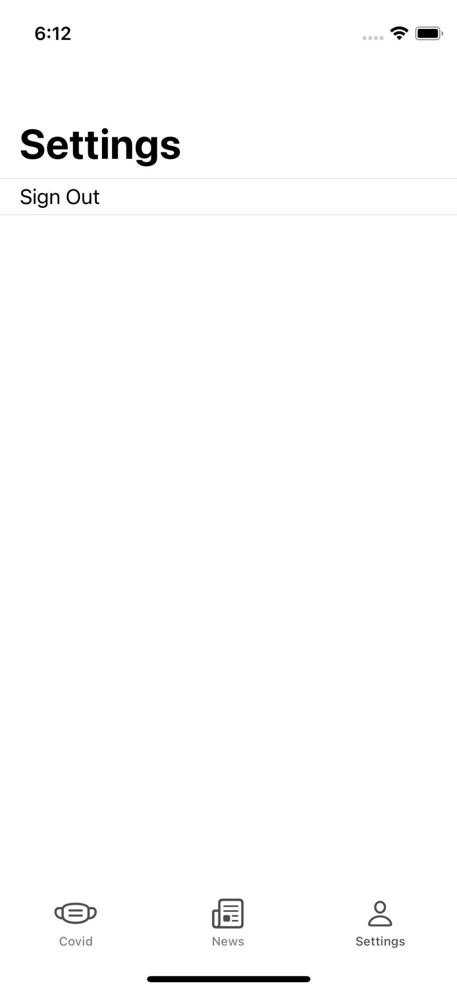
Sign out : You can exit the application , and regstration Again .

Slide 11
Thank you for your Attention .

